Slide 1
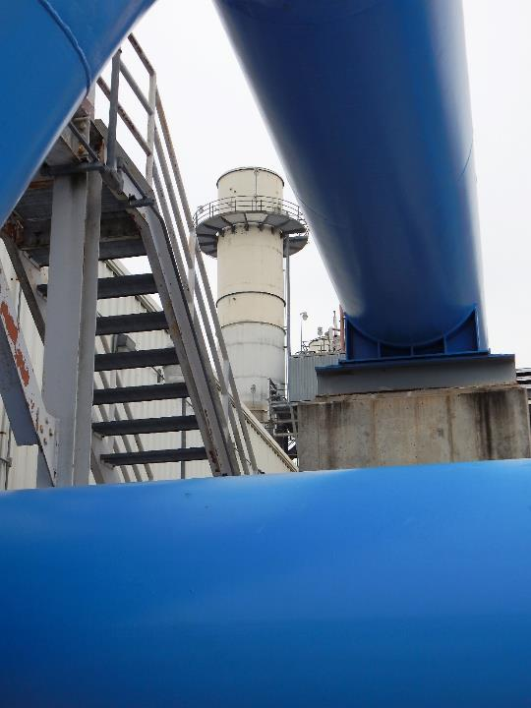
MCe Performance
PORTFOLIO
2025

Slide 2
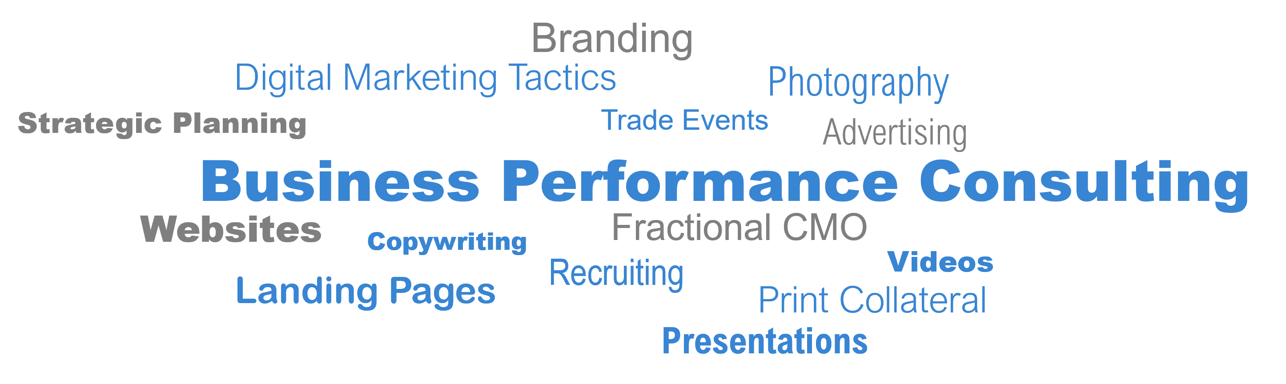
ISO Certification
LISTEN. PLAN. EXECUTE.
Listen to what the audiences and stakeholders are saying, identify their drivers, and determine what the market trends are signaling.
Plan a business/marketing strategy that addresses what we heard from the audiences, stakeholders, and markets. Include a discussion about the competitive landscape.
Execute on the messaging and brand by providing decisive and creative guidance that develops brands and marketing assets that are distinctive, memorable, and transform cultures.
INTRODUCTION

Slide 3
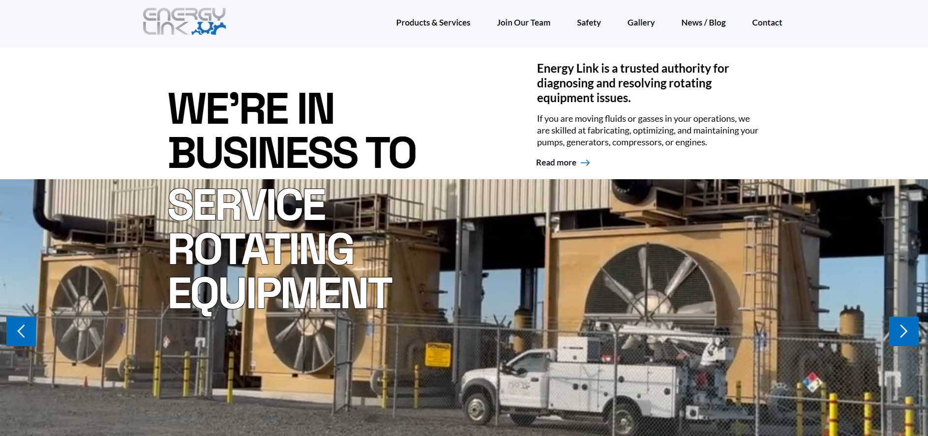
WEBSITES
EnergyLink1.com

Slide 4
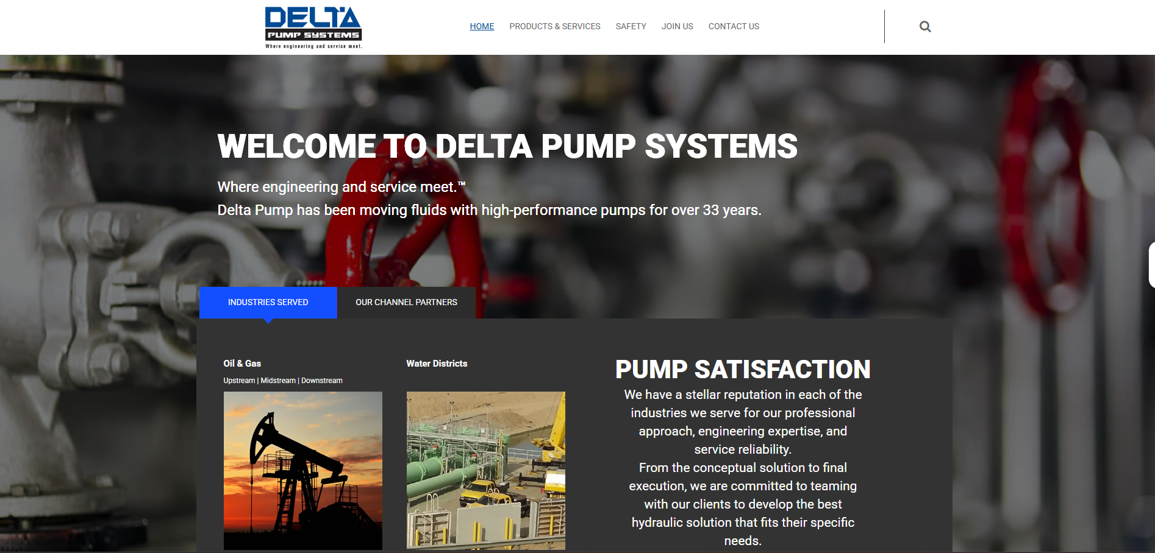
WEBSITES
DeltaPump1.com

Slide 5
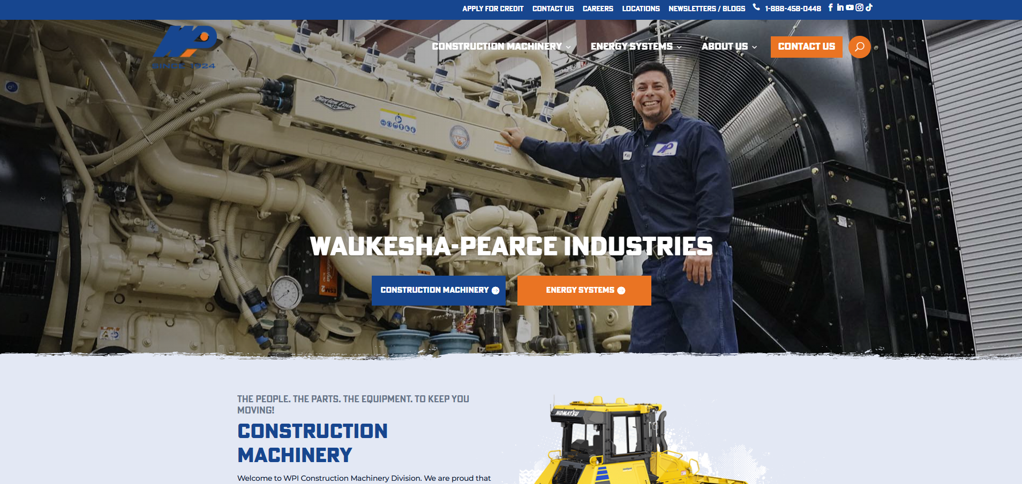
WEBSITES
WPI.com

Slide 6
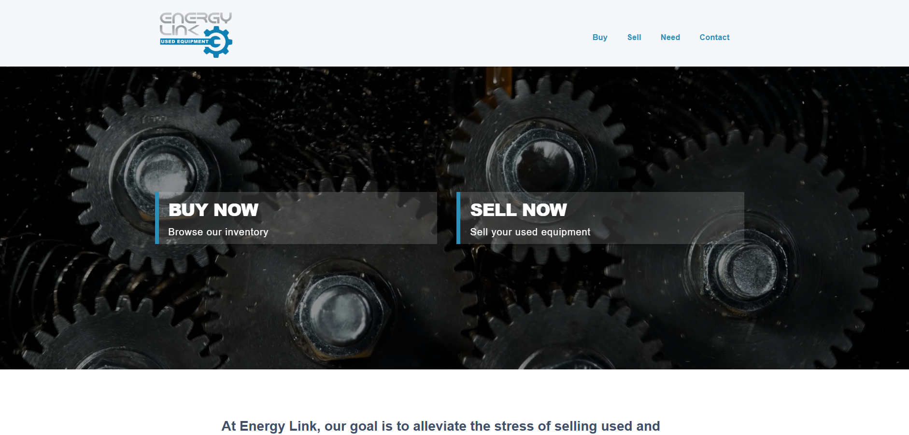
WEBSITES
UsedOilfieldEquipment.energy

Slide 7
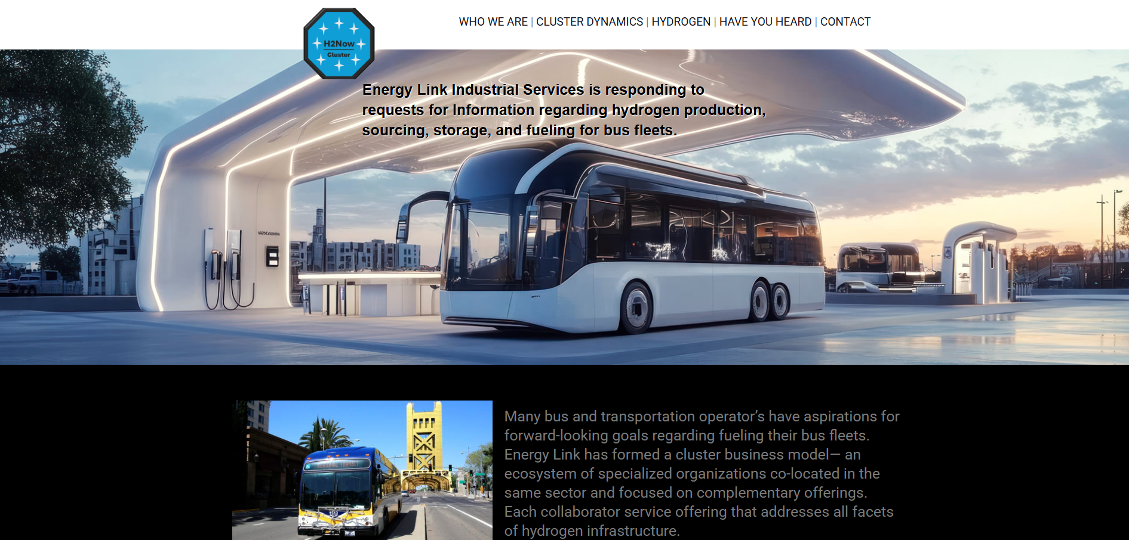
WEBSITES
H2NowCluster.com

Slide 8
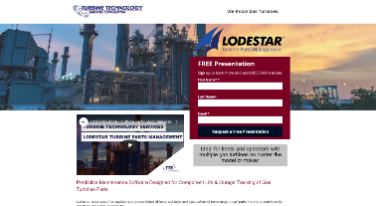
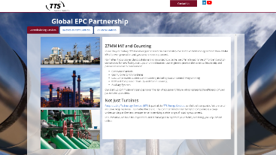

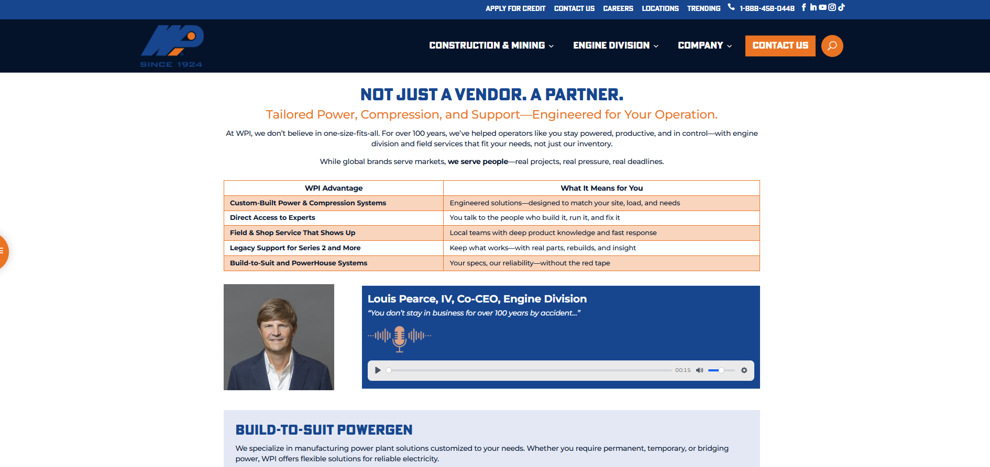

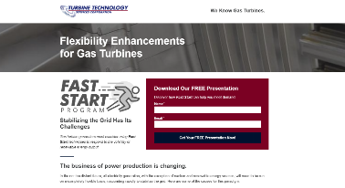
LANDING PAGES
TTSLodestar.com
VintageTurbineReliability.com
TTSFastStart.com
EPCGlobalPartner.com
wpi.com/energy/
PracticalPowerResilience.com
Web pages dedicated to specialty products and services.

Slide 9
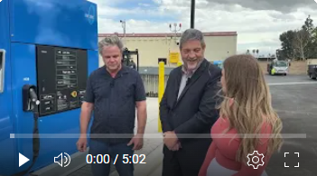
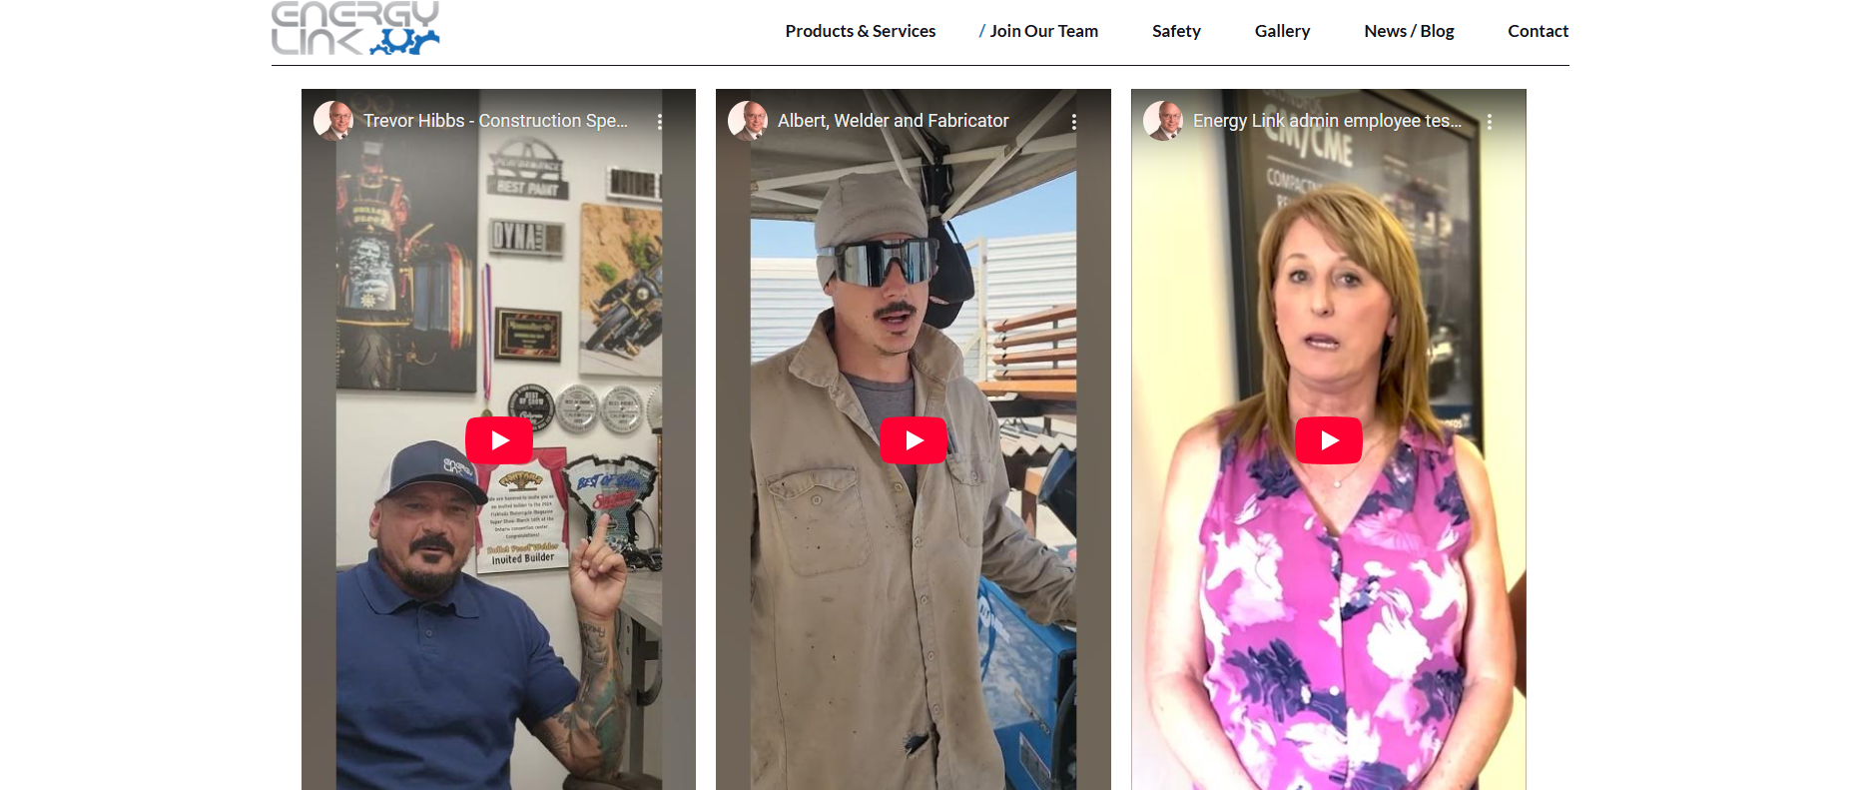
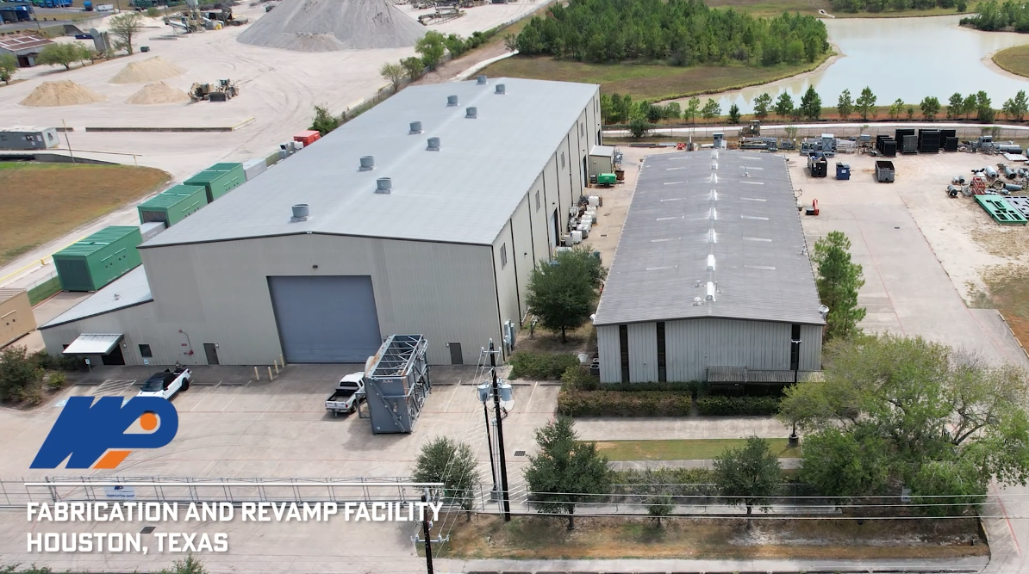
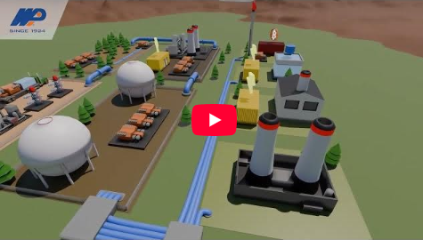
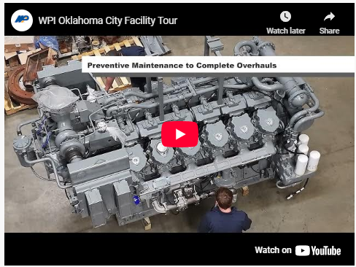
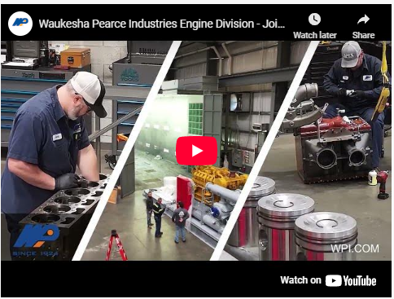
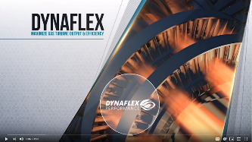


VIDEOS
https://youtu.be/0d85N3n3KMc
https://youtu.be/IIp57xOJI8Q

Slide 10





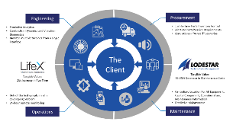



BRANDING
Corporate and Trademarked Sub-Brands
Infographics
Messaging/Taglines

Slide 11
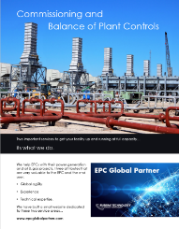





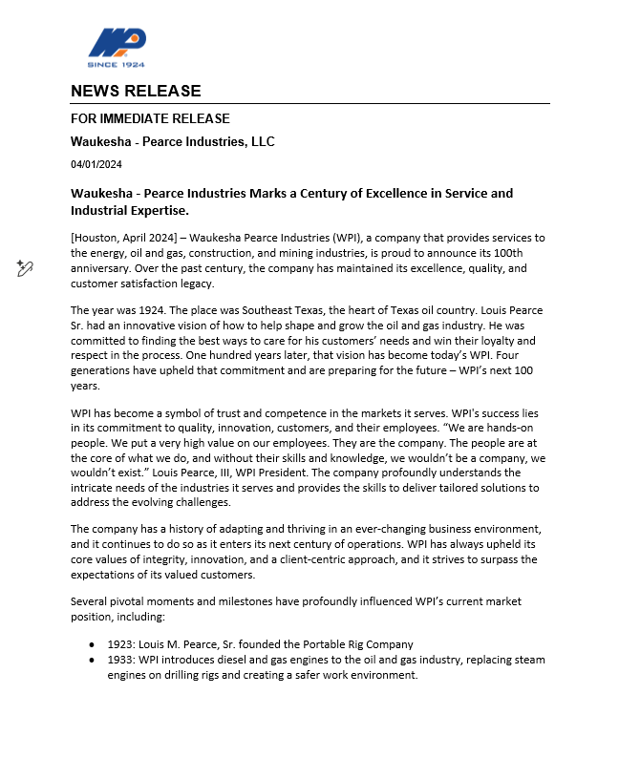
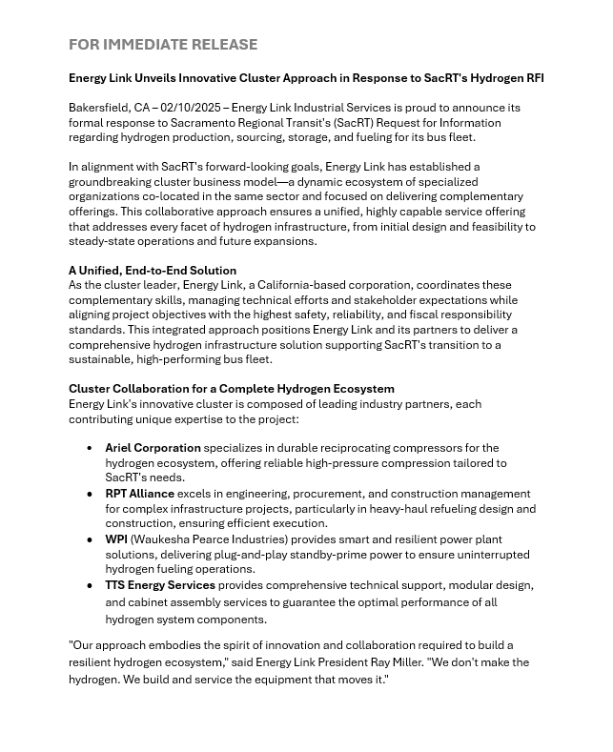

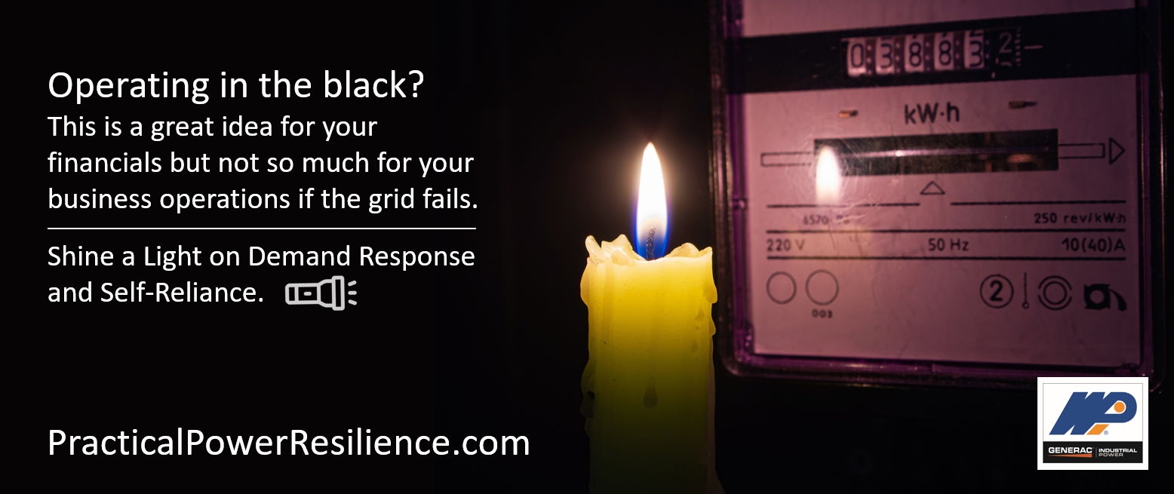
ADVERTISING
Trade Publications
Press Releases
Internal Communications
Email Marketing
LinkedIn Advertising
Blogs/Articles
LinkedIn Posts
and Advertising
Cornerstones of Compression Publication

Slide 12

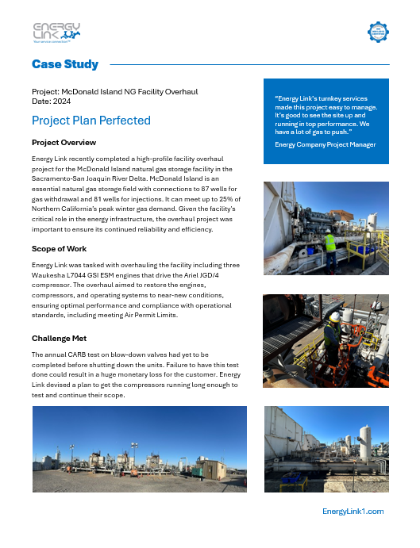

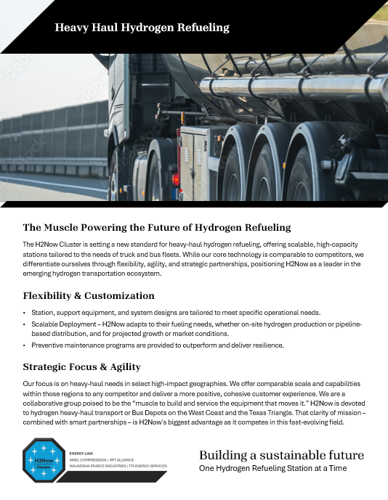
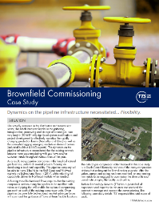

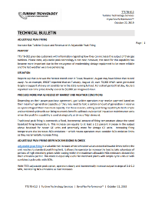
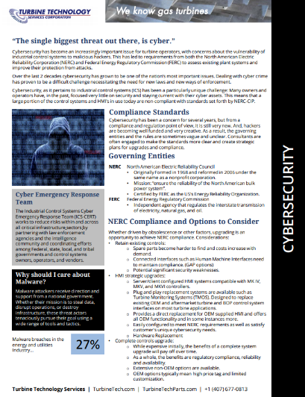
PRINT
Brochures
Line Cards
Case Studies
Training Manuals
Technical Bulletins
New Product Launch

Slide 13

TRADE SHOW
8’X10’

Slide 14
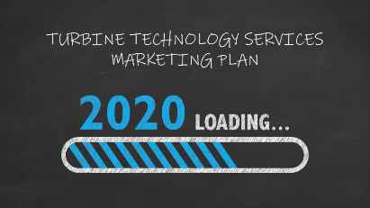



PRESENTATIONS
Internal
Corporate
M&A
Product/Service

Slide 15
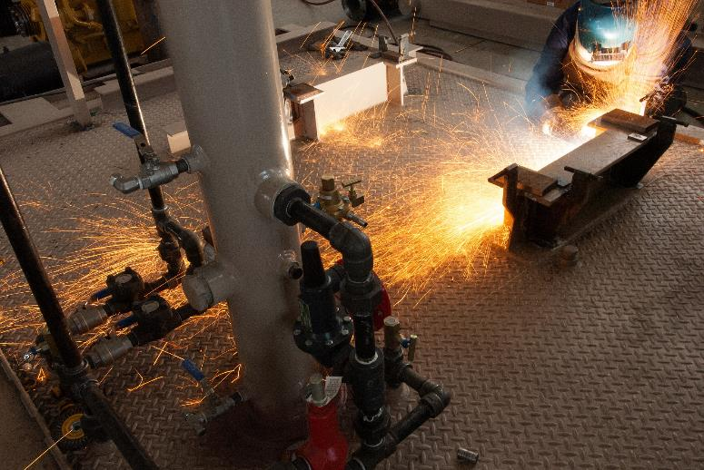
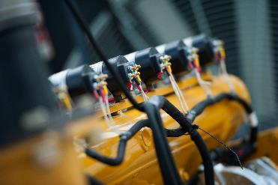

PHOTOGRAPHY

Slide 16
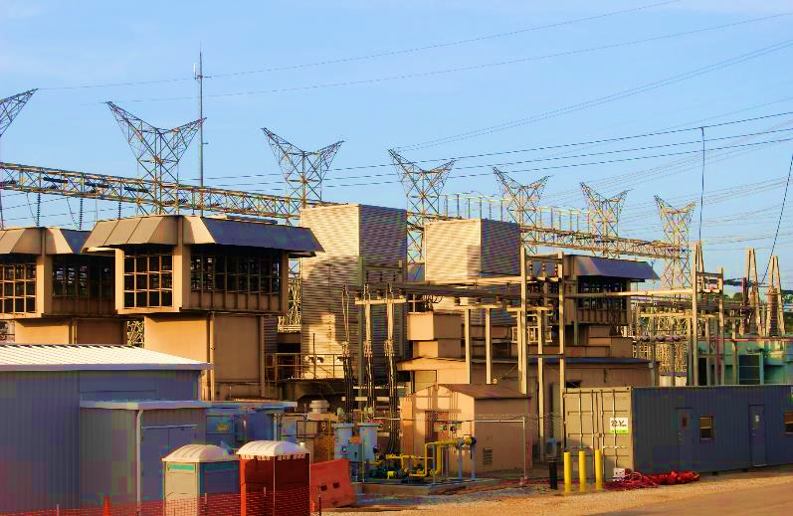
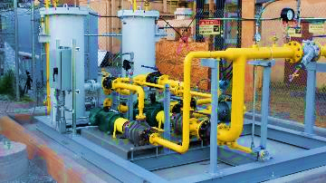
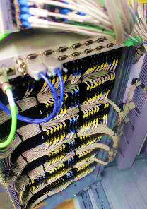
PHOTOGRAPHY

Slide 17
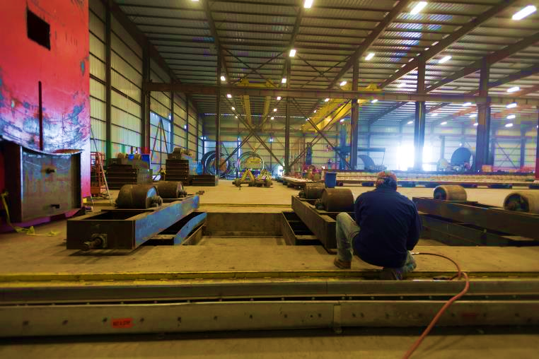
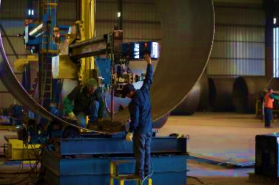
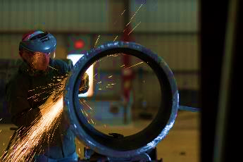
PHOTOGRAPHY

Slide 18
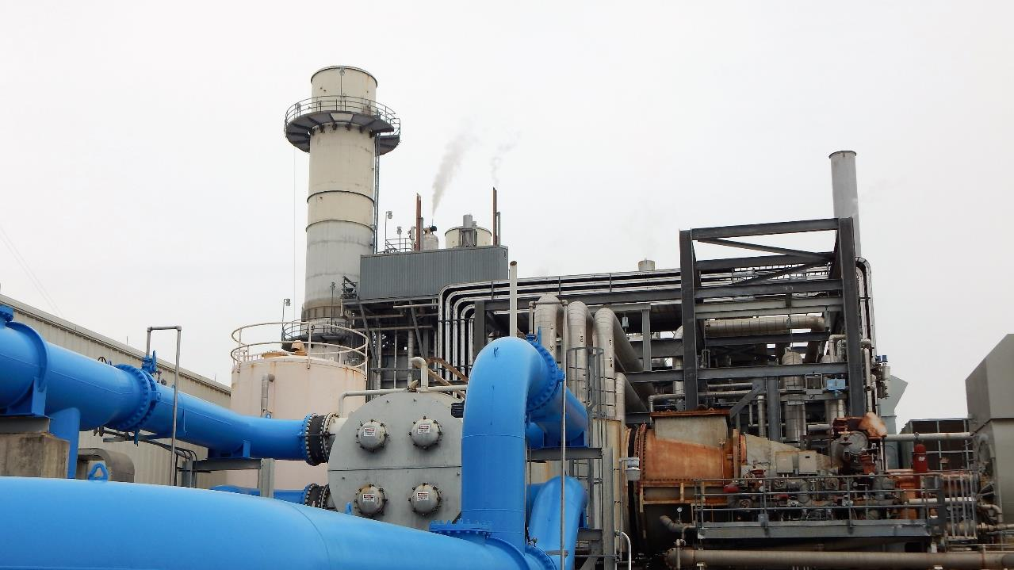
MCe Performance
PORTFOLIO
2025

